Slide 1
HOW TO INSTALL PostgreSQL
Start now!

Slide 2
Using a DB already?
Monday
Tuesday
Wednesday
Thursday
Friday
Homework

Slide 3

What is PostgreSQL
Slidesgo
School
Resources
Instructions
Final Slides
FAQ
- PostgreSQL is a database that follows a relational paradigm
- Database -> Scheme -> Tables -> Column
- A table can have a relation with other tables with Primary Key and Foreign Key

Slide 4
Contact Me
Who’s using it?
Developed in 1986 in
UC Berkeley
Netflix, Spotify, Twitch, Uber, Reddit, Skype, among others
The Pros
PostgreSQL is the 4th most used Database
Good languange supports, Support JSON, Can store complex data types

Slide 5
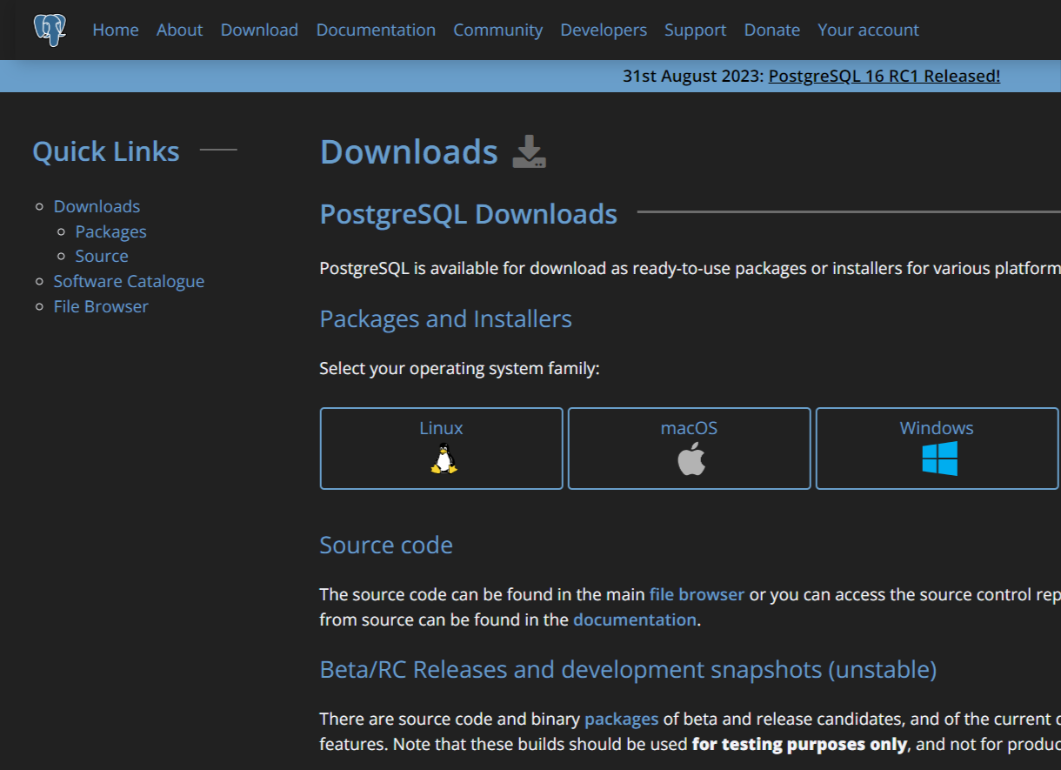
Monday
Tuesday
Wednesday
Thursday
Friday
Homework
Go to https://www.postgresql.org/download/ then select your operating system. In this case, I am going to select Windows as the operating system

Slide 6
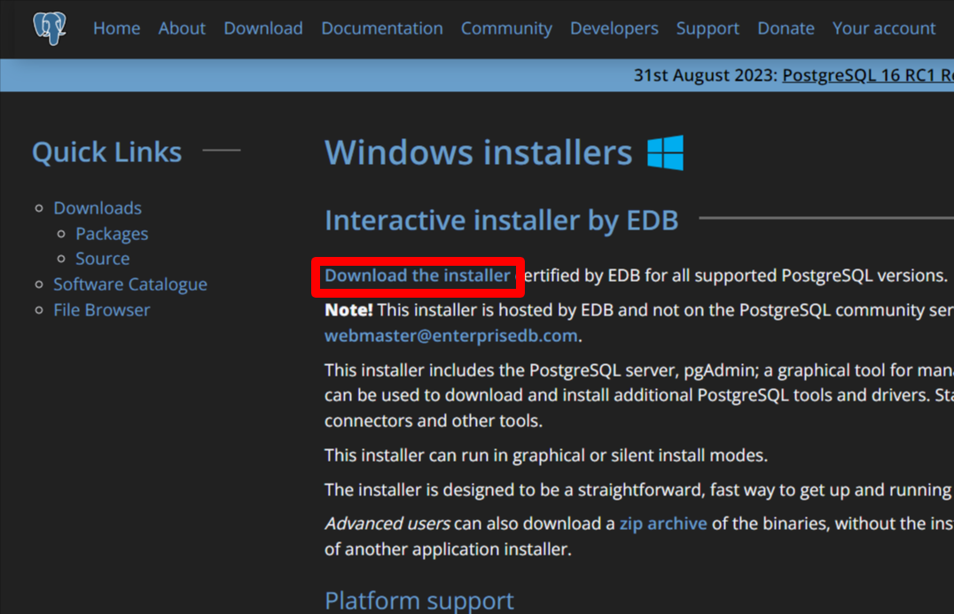
Monday
Tuesday
Wednesday
Thursday
Friday
Homework
Click the highlighted link

Slide 7
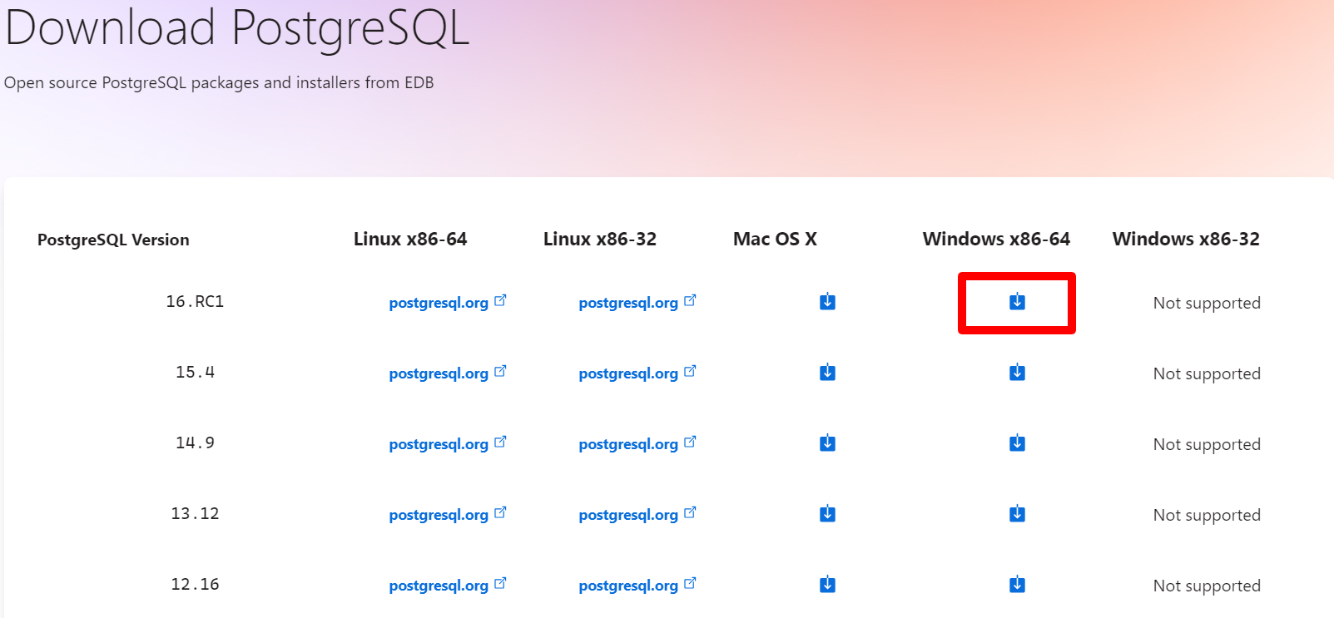
Monday
Tuesday
Wednesday
Thursday
Friday
Homework
Download the latest installer according to your OS, in this case
V-16.RC1, Windows x86-64
Wait for the download to complete

Slide 8
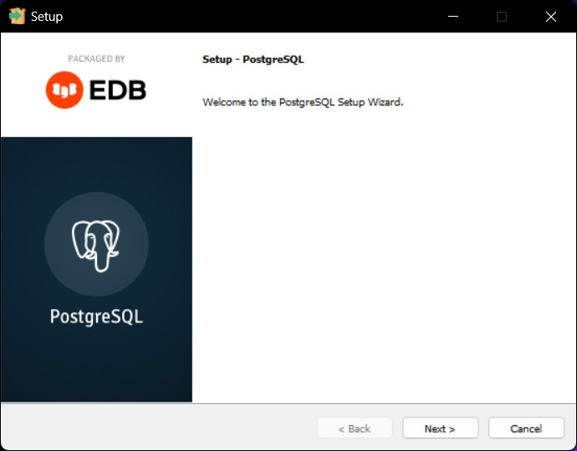
Monday
Tuesday
Wednesday
Thursday
Friday
Homework
Open the installer.
If Windows shows a confirmation screen, click ‘Yes’.
Click Next.

Slide 9
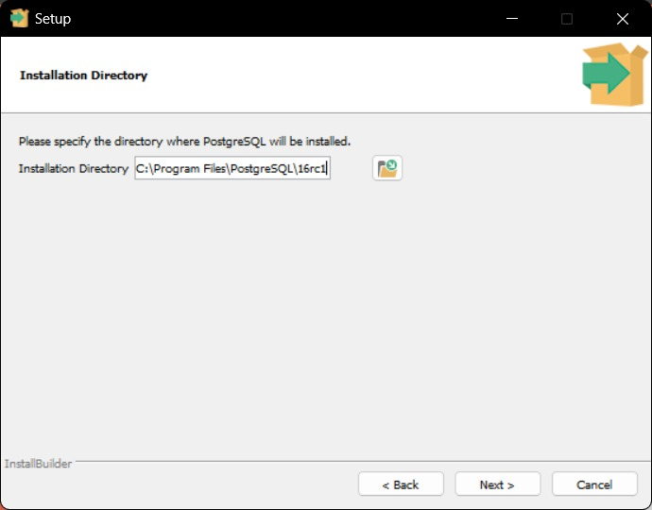
Monday
Tuesday
Wednesday
Thursday
Friday
Homework
Specify an installation directory, or just follow the default directory

Slide 10
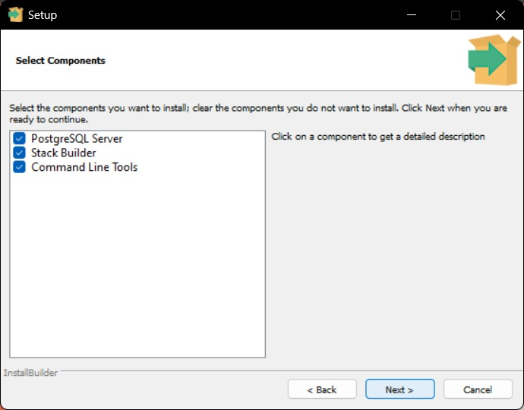
Monday
Tuesday
Wednesday
Thursday
Friday
Homework
Select the components you want to install along with the DB

Slide 11
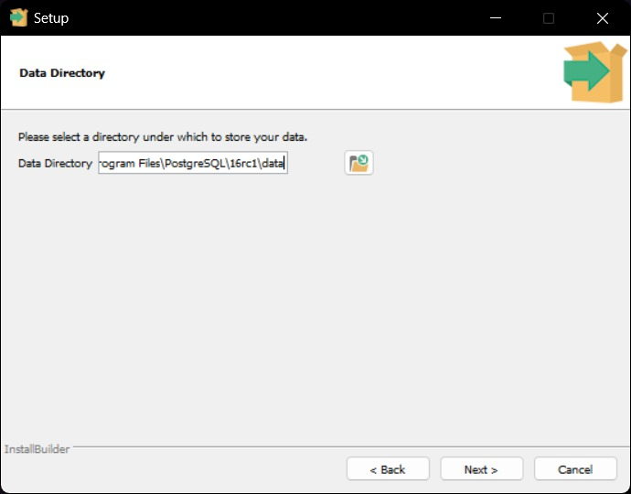
Monday
Tuesday
Wednesday
Thursday
Friday
Homework
Specify a directory to store your DB data, or just follow the default directory

Slide 12
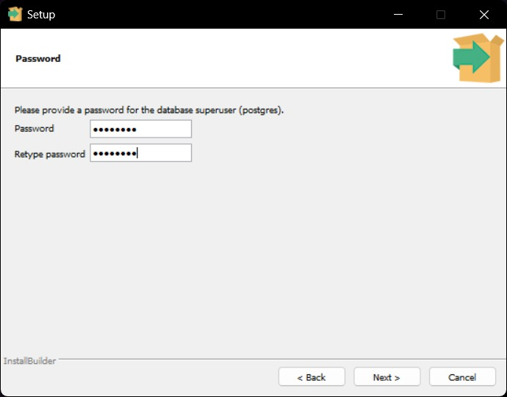
Monday
Tuesday
Wednesday
Thursday
Friday
Homework
Select a password to be your Superuser’s password

Slide 13
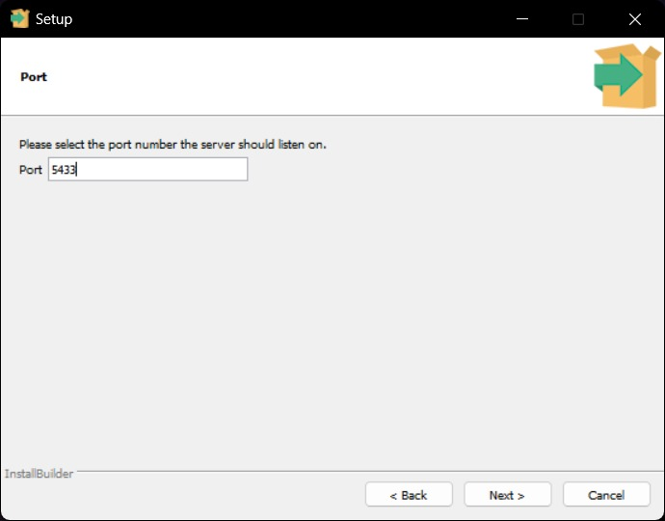
Monday
Tuesday
Wednesday
Thursday
Friday
Homework
Specify a port number for your Database, or just follow the default port number

Slide 14
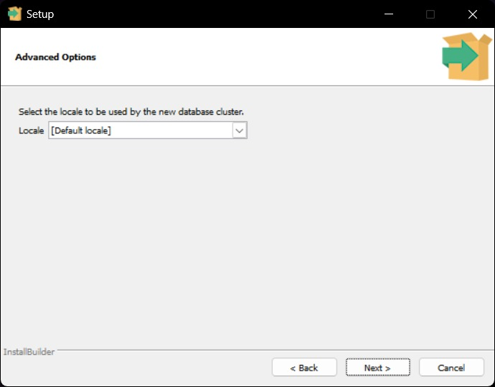
Monday
Tuesday
Wednesday
Thursday
Friday
Homework
Specify a Database cluster (your local region for the Database)

Slide 15
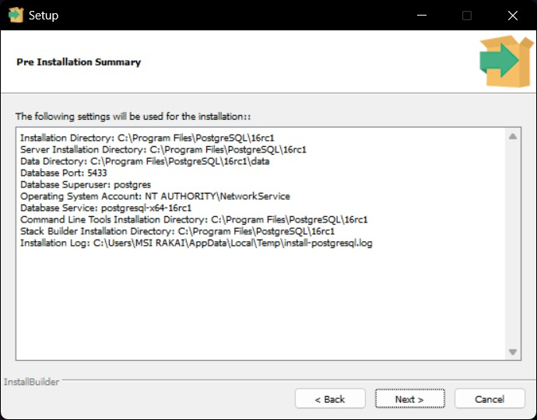
Monday
Tuesday
Wednesday
Thursday
Friday
Homework
Click next 2 times to start the installation process, wait until it’s finished

Slide 16
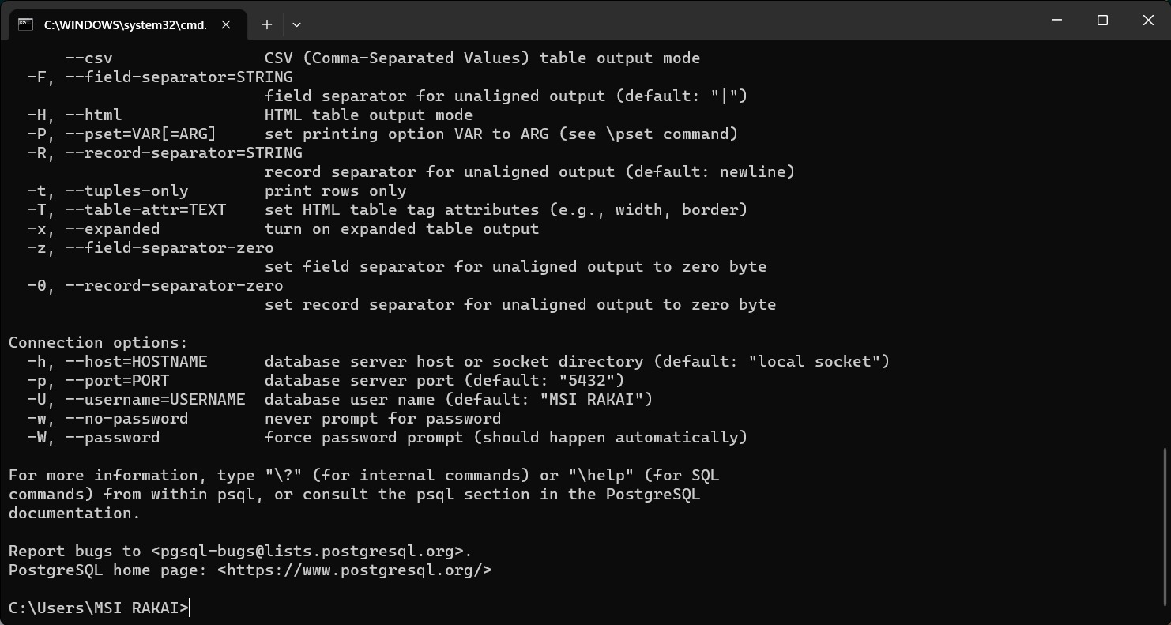
Monday
Tuesday
Wednesday
Thursday
Friday
Homework
Open command prompt and type ‘psql –help’ to ensure that PostgreSQL is already installed

Slide 17
So the conclusion is?
Slidesgo
School
Resources
Instructions
Final Slides
FAQ
In order to Install PostgreSQL you need to:
- Visit PostgreSQL’s website and click download, also choose the installer according to your own Operating System
- After the download is completed, double click the installer to start the installing process
- Follow the steps inside the installer, if there’s some things that you don’t understand, you can follow the default configuration inside the installer
- After the installing process is completed, make sure that PostgreSQL is fully installed by running `psql –help`
- PostgreSQL is installed.

Slide 18
Thank You
Monday
Tuesday
Wednesday
Thursday
Friday
Homework

